Slide 1

Mobile Marketing

Slide 2
Mobile Marketing
Definition
People using mobile for various activities.
The level of personal engagement that the cellular platform provides for consumers has immense potential for marketers.
Mobile as marketing medium is growing exponentially and opening new avenues for the consumer’s engagement.
“ The use of wireless media (primarily cellular phones and PDA’s) as an integrated content delivery and direct response vehicle within a cross media marketing programmes.”

Slide 3
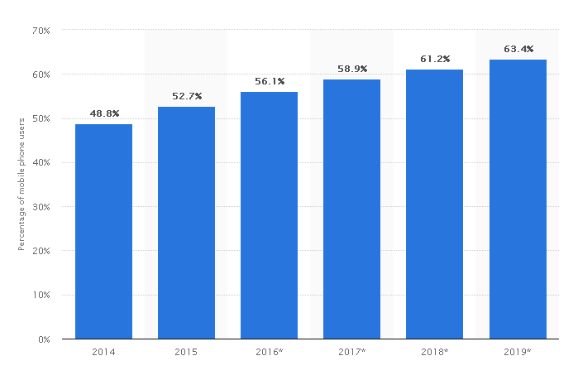
Mobile Marketing
Mobile phone internet user penetration worldwide from 2014 to 2019

Slide 4
Mobile Marketing
Mobile Advertising
The mobile advertisement spectrum ranges from short messages (SMS) text to interactive advertisement.
The size of mobile Internet advertising is expected to grow manifold over the next few years in India.

Slide 5
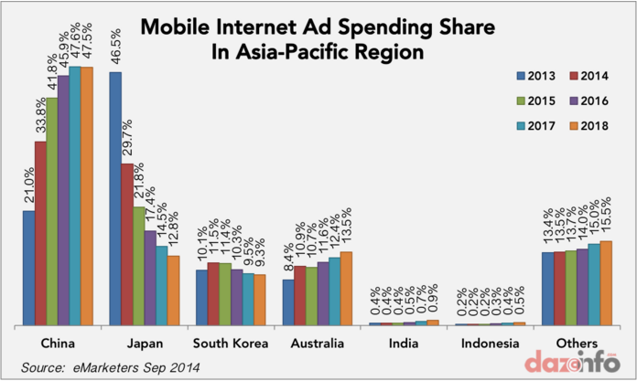
Mobile Marketing
Mobile Advertising

Slide 6
Mobile Marketing
Mobile Advertising Models
On-Device Advertising
  Network based advertising
  Off-Network advertising
Off-Device Advertising

Slide 7
Mobile Marketing
On-Device Advertising
Marketers can engage consumers on their mobile devices through two routes-
  Network Based Advertising
  Off-Network Advertising

Slide 8
Mobile Marketing
Off Device Advertising
SMS PIN for redemption
BARCODES
Games/Application downloads
Ringtone downloads
Image downloads
Missed call to a given number

Slide 9
Mobile Marketing
Advantages
Lower cost and Efficiency
Relevant and accurate data for powerful Analytics and Targeting
Better Engagement
User context and profile
High reach
Media dark communication
Personalized communication
Versatility of Message formats

Slide 10
Mobile Marketing
Toolkit
Offers broad range of tools to reach and engage consumers on their mobile devices.
These can be paid, owned or earned by the brand.
This refers as POE framework of mobile marketing.

